Slide 1

Functional
Testing

Slide 2
Functional Testing
Functional Testing or Black Box Testing is a strategy in which testing is based solely on the requirements and specifications. Unlike its complement, white box testing, black box testing requires no knowledge of the internal paths, structure, or implementation of the software under test (SUT).

Slide 3
Functional Testing
Testing is based on the functionality of the program.
Internal structure of the code is ignored.
Black Box Testing
Input test data
Output test data
System

Slide 4
Functional Testing
The general functional testing process is:
The requirements or specifications are analyzed.
Valid inputs are chosen based on the specification to determine that the SUT processes them correctly. Invalid inputs must also be chosen to verify that the SUT detects them and handles them properly.
Expected outputs for those inputs are determined.
Tests are constructed with the selected inputs.
The tests are run. Actual outputs are compared with the expected outputs.

Slide 5
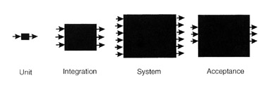
Applicability
Black box testing can be applied at all levels of system development—unit, integration, system, and acceptance.

Slide 6
As we move up in size from module to subsystem to system the box gets larger, with more complex inputs and more complex outputs, but the approach remains the same. Also, as we move up in size, we are forced to the black box approach; there are simply too many paths through the SUT to perform white box testing.

Slide 7
Functional Testing
Boundary Value Analysis
Boundary conditions have a higher chances of detecting an error.
Directly on
Just above
Just below
The boundary of inputs

Slide 8
Functional Testing
Consider the function F with two input variables x and y.
a ≤ x ≤ b
c ≤ y ≤ d
x & y are bounded by two intervals [a,b] and [c,d].

Slide 9
Functional Testing
y
d
c
x
a
b
Any point within shaded rectangle is a legitimate input to the function.

Slide 10
Functional Testing
Basic idea is to use input variable values at their
Minimum
Just above minimum
A nominal value
Just below their maximum
Maximum

Slide 11
Functional Testing
Assumption of reliability theory
Single fault assumption theory says that failures are only rarely the result of the simultaneous occurrence of two (or more) faults

Slide 12
Functional Testing
Test cases
<x_{nom}, y_{min}>,<x_{nom}, y_{min+}>,
<x_{nom}, y_{nom}>,<x_{nom}, y_{max-}>,
<x_{nom}, y_{max}>,<x_{min}, y_{nom}>,
<x_{min+}, y_{nom}>,<x_{nom}, y_{nom}>,
<x_{max-}, y_{nom}>,<x_{max}, y_{nom}>,

Slide 13
Functional Testing
y
d
c
x
a
b
Boundary value analysis of test cases for a function of two variables.

Slide 14
Functional Testing
Thus, for a function of n variables, boundary value analysis yields
4n+1 test cases

Slide 15
Functional Testing
Limitations
  Variables to be truly independent
  Physical quantities
temp
pressure
speed
load
  Boolean variables
True
False

Slide 16
Functional Testing
Robustness Testing
Extension of boundary value analysis.
We see, what happens when values exceeds greater then maximum (max⁺) and value slightly less than minimum (min⁻)

Slide 17
Functional Testing
y
d
c
x
a
b
Robustness test cases for a function of two variables.

Slide 18
Functional Testing
Worst Case Testing
We assume single fault assumption of reliability theory.
Rejecting this means that we are interested in what happens when more than one variable has an extreme value.
In electronic circuit analysis, this is called ‘worst case analysis’ set.
min
min⁺
nom
max⁻
max
5^{n} test cases
4n+1 test cases

Slide 19
Functional Testing
y
d
c
x
a
b
Worst test cases for a function of two variables

Slide 20
Functional Testing
y
d
c
x
a
b
Robust worst case test cases for a function of two variables.

Slide 21
Functional Testing
Special value testing
Most intuitive & least uniform.
It occurs when a tester uses domain knowledge experience with similar programs and information about soft spots to devise test cases. This is also called adhoc testing.
Dependent on the abilities of the tester.

Slide 22
Functional Testing
The Next Date Function
Next Date is a function of three variables: month, date, and year. It returns the date of the day after the input date. The month, date, and year variables have integer values subject to these conditions:
C1 : 1 ≤ month ≤ 12
C2 : 1 ≤ day ≤ 31
C3 : 1812 ≤ year ≤ 2012

Slide 23
Software Testing
Next Date function
Case | Month | Day | Year | Expected output
1 | 6 | 15 | 1812 | June 16, 1812
2 | 6 | 15 | 1813 | June 16, 1813
3 | 6 | 15 | 1912 | June 16, 1912
4 | 6 | 15 | 2011 | June 16, 2011
5 | 6 | 15 | 2012 | June 16, 2012
6 | 6 | 1 | 1912 | June 2, 1912
7 | 6 | 2 | 1912 | June 3, 1912
8 | 6 | 15 | 1912 | June 16, 1912
9 | 6 | 30 | 1912 | July 1, 1912
10 | 6 | 31 | 1912 | Invalid Date
11 | 1 | 15 | 1912 | January 16, 1912
12 | 2 | 15 | 1912 | February 16, 1912
13 | 6 | 15 | 1912 | June 16, 1912
14 | 11 | 15 | 1912 | November 16, 1912
15 | 12 | 15 | 1912 | December 16, 1912

Slide 24
Software Testing
Total 4n+1=13
Two are common
Worst-Case Test Cases
= 5^{n}
=5³ = 125
Only one value will be changed & other two are at nominal values.

Slide 25
Functional Testing
The commission Problem
A rifle salesperson in a state sold rifle locks, stocks and barrels made by a gunsmith. Locks cost $45, stocks cost $30, and barrels cost $25. The salesperson had to sell at least one complete rifle per month and production limits were such that the most of the salesperson could sell in a month was 70 locks, 80 stocks, and 90 barrels. After each town visit, the salesperson sent a telegram to the company with the number of locks, stocks, and barrels sold in that town. At the end of the month, the salesperson sent a very short telegram showing -1 locks sold. The gunsmith then knew the sales for the month were complete and computed the salesperson’s commission as follows:

Slide 26
Functional Testing
10% on sales upto $1000
15% on the next $900
20% on any sales in excess of $1800
The commission program produced a monthly sales report that gave the total number of locks, stocks, and barrels sold, the salesperson’s total sales, and finally the commission.

Slide 27
Functional Testing
Instead of going through 125 test cases again, we consider other interesting test cases.
We look at boundary values for the output range, especially near the threshold points of $1000 and $1800. The output space of the commission is shown below. The intercepts of these threshold planes with the axes are shown.

Slide 28
Functional Testing
90
72
40
22.2
40
70
locks
33.3
60
stocks
80

Slide 29

Software Testing
Test Case | Locks | Stocks | Barrels | Sales | Comm | Comment
1 | 1 | 1 | 1 | 100 | 10 | Output minimum
2 | 1 | 1 | 2 | 125 | 12.5 | Output minimum+
3 | 1 | 2 | 1 | 130 | 13 | O/p min+
4 | 2 | 1 | 1 | 145 | 14.5 | O/p min+
5 | 5 | 5 | 5 | 500 | 50 | Mid point
6 | 10 | 10 | 9 | 975 | 97.5 | Border point-
7 | 10 | 9 | 10 | 970 | 97 | Border point-
8 | 9 | 10 | 10 | 955 | 95.5 | Border point-
9 | 10 | 10 | 10 | 1000 | 100 | Border point
10 | 10 | 10 | 11 | 1025 | 103.75 | Border point+
11 | 10 | 11 | 10 | 1030 | 104.5 | Border pt+
12 | 11 | 10 | 10 | 1045 | 106.75 | Border pt+
13 | 14 | 14 | 14 | 1400 | 160 | Mid point
14 | 18 | 18 | 17 | 1775 | 216.25 | Border pt-
15 | 18 | 17 | 18 | 1770 | 215.5 | Border pt-

Slide 30
Software Testing
Test Case | Locks | Stocks | Barrels | Sales | Comm | Comment
16 | 17 | 18 | 18 | 1755 | 213.25 | Border pt-
17 | 18 | 18 | 18 | 1800 | 220 | Border pt
18 | 18 | 18 | 19 | 1825 | 225 | Border pt+
19 | 18 | 19 | 18 | 1830 | 226 | Border pt+
20 | 19 | 18 | 18 | 1845 | 229 | Border pt+
21 | 48 | 48 | 48 | 4800 | 820 | Mid point
22 | 70 | 80 | 89 | 7775 | 1415 | Out max-
23 | 70 | 79 | 90 | 7770 | 1414 | Out max-
24 | 69 | 80 | 90 | 7755 | 1411 | Out max-
25 | 70 | 80 | 90 | 7800 | 1420 | Out max

Slide 31
Applicability and Limitations
Boundary value testing can significantly reduce the number of test cases that must be created and executed. It is most suited to systems in which much of the input data takes on values within ranges or within sets.
Boundary value testing is equally applicable at the unit, integration, system, and acceptance test levels. All it requires are inputs that can be partitioned and boundaries that can be identified based on the system's requirements.

Slide 32
Practice
The following exercises refer to the Stateless University Registration System Web site described in Appendix B. Define the boundaries, and suitable boundary value test cases for the following:
ZIP Code-five numeric digits.
First consider ZIP Code just in terms of digits. Then, determine the lowest and highest legitimate ZIP Codes in the United States. For extra credit [1], determine the format of postal codes for Canada and the lowest and highest valid values.
Last Name-one through fifteen characters (including alphabetic characters, periods, hyphens, apostrophes, spaces, and numbers). For extra credit [2] create a few very complex Last Names. Can you determine the "rules" for legitimate Last Names? For additional extra credit [3] use a phonebook from another country-try Finland or Thailand.
User ID-eight characters at least two of which are not alphabetic (numeric, special, nonprinting).
Course ID-three alpha characters representing the department followed by a six-digit integer which is the unique course identification number. The possible departments are:
  PHY - Physics
  EGR - Engineering
  ENG - English
  LAN - Foreign languages
  CHM - Chemistry
  MAT - Mathematics
  PED - Physical education
  SOC - Sociology
[1]There actually is no extra credit, so do it for fun.
[2]There actually is no extra credit, so do it for fun.
[3]There actually is no extra credit, so do it for fun.

Slide 33
Functional Testing
Equivalence Class Testing
If we expect the same result from two test case, we consider them equivalent.
A group of test cases forms an equivalent class if
They all test the same thing
If one test catches a bug, the others probably will too.
If one test does not catch a bug, the others probably would not either.

Slide 34
Functional Testing
Equivalence Classes
Important aspect of equivalence classes is that they form a partition of a set, where partition refers to a collection of mutually disjoint subsets when the union is the entire set.
Implications for testing
Completeness
Non redundancy

Slide 35
Functional Testing
Subsets are determined by an equivalence relation, the elements of a subset have something in common.
The idea is to identify test cases by using one element from each equivalence class.

Slide 36
Functional Testing
Consider the function F with input variables x1 and x2 that have the following boundaries, and intervals within the boundaries.
a ≤ x₁ ≤ d with intervals [a,b), [b,c), [c,d]
e ≤ x₂ ≤ g with intervals [e,f), [f,g]
Where square brackets & parentheses denote, respectively, closed and open interval end points.
Invalid values of x₁ and x₂ are:
        X₁<a, x1>d
        X₂<e, x2>g

Slide 37
Functional Testing
Weak Normal Equivalence Class Testing
We use one variable from each equivalence class (interval) in a test case.
(Note the effect of single fault assumption)

Slide 38
Functional Testing
x₂
g
f
e
x₁
a
b
c
d
Fig.1: Weak Normal Equivalence class Test Cases

Slide 39
Functional Testing
These three test cases uses one value from each equivalence class.
We will always have same number of weak equivalence class test cases as classes in the partition with the largest number of subsets.
Strong Normal Equivalence Class Testing
It is based on the multiple fault assumption, so we need test cases from each element of the cartesian product of the equivalence class as shown in the figure.

Slide 40
Functional Testing
x₂
g
f
e
x₁
a
b
c
d
Fig.2: Strong Normal Equivalence class Testing

Slide 41
Functional Testing
Weak Robust Equivalence Class Testing
How can something be both weak and robust? The robust part comes from consideration of invalid values and weak part refers to single fault assumption.
This is also referred to as traditional equivalence class testing.
For valid inputs, use one value from each valid class (as in weak normal equivalence class testing, where each input is valid).
For invalid inputs, a test case will have one invalid value and the remaining values will be valid. (Thus a single failure should cause the test case to fail).

Slide 42
Functional Testing
x₂
g
f
e
x₁
a
b
c
d
Fig.3

Slide 43
Functional Testing
Strong Robust Equivalence Class Testing
Strong
Robust
Invalid inputs
Multiple fault assumption theory
We obtain test cases from each element of the Cartesian product of all the equivalence classes as shown in figure 4.

Slide 44
Functional Testing
x₂
g
f
e
x₁
a
b
c
d
Fig.4

Slide 45
Functional Testing
Next Date Function
Three variables
  month
  day
  year
Intervals of Valid Values
M₁=[month:1≤month≤12]
D₁=[day:1≤day≤31]
Y₁=[year:1812≤year≤2012]

Slide 46
Functional Testing
Invalid equivalence classes are
M₂=[month : month<1]
M₃=[month : month>12]
D₂=[day : day<1]
D₃=[day : day>31]
Y₂=[year : year<1812]
Y₃=[year : year>2012]

Slide 47
Functional Testing
Because the number of valid classes equals the number of independent variables, only one weak normal equivalence class test case occurs and is identical to the strong normal equivalence class test case.
Case ID | Month | Day | Year | Expected output
WNI SNI | 6 | 15 | 1912 | 16/6/1912

Slide 48
Software Testing
Weak Robust Test Cases
Case ID | Month | Day | Year | Expected output
WR1 | 6 | 15 | 1912 | 16/6/1912
WR2 | -1 | 15 | 1912 | Value of month not in range 1..12
WR3 | 13 | 15 | 1912 | - do -
WR4 | 6 | -1 | 1912 | Value of day not in 1..31
WR5 | 6 | 32 | 1912 | - do -
WR6 | 6 | 15 | 1811 | Value of year not in range 1812..2012
WR7 | 6 | 15 | 2013 | - do -

Slide 49
Functional Testing
Here is one corner of the cube in 3-space of the additional strong robust equivalence class test cases.
Case ID | Month | Day | Year | Expected output
SR1 | -1 | 15 | 1912 | Value of month not in range 1..12
SR2 | 6 | -1 | 1912 | Value of day not in range 1..31
SR3 | 6 | 15 | 1811 | Value of year not in range 1812..2012
SR4 | -1 | -1 | 1912 | Value of month & day not in range
SR5 | 6 | -1 | 1811 | Value of day & year not in range
SR6 | -1 | 15 | 1811 | Value of month & year not in range
SR7 | -1 | -1 | 1811 | Value of month, date and year not in range

Slide 50
Functional Testing
Modified Form
M₁ ={month : month has 30 days}
M₂={month : month has 31 days}
M₃={month : month is February}
D₁={day : 1≤day 28}
D₂={day : day=29}
D₃={day : day=30}
D₄={day : day=31}
Y₁={year : year=2000}
Y₂={year : year is a leap year}
Y₃={year : year is a common year}

Slide 51
Functional Testing
Case ID | Month | Day | Year | Expected output
WN1 | 6 | 14 | 2000 | 15/6/2000
WN2 | 7 | 29 | 1996 | 30/7/1996
WN3 | 2 | 30 | 2002 | Invalid Date
WN4 | 6 | 31 | 2000 | Invalid Date

Slide 52
Functional Testing
Mechanical selection of input values makes no consideration of our domain knowledge thus two invalid dates.
This will always be a problem with automatic test case generation, because domain knowledge is not captured in the choice of equivalence classes.

Slide 53
Functional Testing
Strong Normal equivalence class test cases for revised classes are
Case ID | Month | Day | Year | Expected output
SN1 | 6 | 14 | 2000 | 15/6/2000
SN2 | 6 | 14 | 1996 | 15/6/1996
SN3 | 6 | 14 | 2002 | 15/6/2002
SN4 | 6 | 29 | 2000 | 30/6/2000
SN5 | 6 | 29 | 1996 | 30/6/1996
SN6 | 6 | 29 | 2002 | 30/6/2002
SN7 | 6 | 30 | 2000 | 1/7/2000 1/7/1996 1/7/2002
SN8 | 6 | 30 | 1996
SN9 | 6 | 30 | 2002
SN10 | 6 | 31 | 2000 | Invalid Input Invalid Input Invalid Input
SN11 | 6 | 31 | 1996
SN12 | 6 | 31 | 2002
SN13 | 7 | 14 | 2000 | 15/7/2000
SN14 | 7 | 14 | 1996 | 15/7/1996
SN15 | 7 | 14 | 2002 | 15/7/2002

Slide 54
Functional Testing
Case ID | Month | Day | Year | Expected output
SN16 | 7 | 29 | 2000 | 30/7/2000
SN17 | 7 | 29 | 1996 | 30/7/1996
SN18 | 7 | 29 | 2002 | 30/7/2002
SN19 | 7 | 30 | 2000 | 31/7/2002
SN20 | 7 | 30 | 1996 | 31/7/1996
SN21 | 7 | 30 | 2002 | 31/7/2002
SN22 | 7 | 31 | 2000 | 1/8/2000
SN23 | 7 | 31 | 1996 | 1/8/1996
SN24 | 7 | 31 | 2002 | 1/8/2002
SN25 | 2 | 14 | 2000 | 15/2/2000
SN26 | 2 | 14 | 1996 | 15/2/1996
SN27 | 2 | 14 | 2002 | 15/2/2002
SN28 | 2 | 29 | 2000 | 1/3/2000
SN29 | 2 | 29 | 1996 | 1/3/1996
SN30 | 2 | 29 | 2002 | Invalid date

Slide 55
Functional Testing
Case ID | Month | Day | Year | Expected output
SN31 | 2 | 30 | 2000 | Invalid Date Invalid Date Invalid Date
SN32 | 2 | 30 | 1996
SN33 | 2 | 30 | 2002
SN34 | 2 | 31 | 2000 | Invalid Date Invalid Date Invalid Date
SN35 | 2 | 31 | 1996
SN36 | 2 | 31 | 2002
If we add invalid two classes for each variable, total result in 150 strong robust equivalence class test cases.

Slide 56
Applicability and Limitations
Equivalence class testing can significantly reduce the number of test cases that must be created and executed. It is most suited to systems in which much of the input data takes on values within ranges or within sets. It makes the assumption that data in the same equivalence class is, in fact, processed in the same way by the system. The simplest way to validate this assumption is to ask the programmer about their implementation.
Equivalence class testing is equally applicable at the unit, integration, system, and acceptance test levels. All it requires are inputs or outputs that can be partitioned based on the system's requirements.

Slide 57
Practice
The following exercises refer to the Stateless University Registration System Web site described in Appendix B. Define the equivalence classes and suitable test cases for the following:
  ZIP Code—five numeric digits.
  State—the standard Post Office two-character abbreviation for the states, districts, territories, etc. of the United States.
  Last Name—one through fifteen characters (including alphabetic characters, periods, hyphens, apostrophes, spaces, and numbers).
  User ID—eight characters at least two of which are not alphabetic (numeric, special, nonprinting).
  Student ID—eight characters. The first two represent the student's home campus while the last six are a unique six-digit number. Valid home campus abbreviations are: AN, Annandale; LC, Las Cruces; RW, Riverside West; SM, San Mateo; TA, Talbot; WE, Weber; and WN, Wenatchee.

Slide 58
Functional Testing
Decision Table Based Testing
Decision tables are an excellent tool to capture kinds of system requirements and to document internal system design. They are used to record complex rules that a system must implement. In addition, they can serve as a guide to creating test cases.
Decision tables are a vital tool in the tester’s personal toolbox. Unfortunately, many analysts, designers, programmer, and testers are not familiar with this technique.
Useful when number of combination of actions are taken under varying set of conditions.

Slide 59
Functional Testing
Condition Stub C₁ C₂ C₃ | Entry
 | True |  |  |  | False
 | True |  | False |  | True |  | False
 | True | False | True | False | True | False | True | False
Action a₁ Stub a₂ a₃ a₄ | X | X |  |  | X
 | X |  | X |  |  | X
 |  | X |  |  | X
 |  |  |  | X |  | X | X

Slide 60
Functional Testing
Next Date Function
It illustrates the problem of dependencies in the input domain.
First Attempts
Identifying appropriate conditions and actions presents an opportunity for craftsmanship.

Slide 61
Functional Testing
Month
M₁ ={month : month has 30 days}
M₂={month : month has 31 days}
M₃={month : month is February}
Day
D₁={day : 1≤day ≤28}
D₂={day : day=29}
D₃={day : day=30}
D₄={day : day=31}
Year
Y₁={year : year is a leap year}
Y₂={year : year is a common year}

Slide 62
Functional Testing
Conditions
C₁ : month in M₁ ? | T
C₂ : month in M₂ ? | -- | T
C₃ : month in M₃ ? | -- | -- | T
C₄ : day in D₁ ?
C₅ : day in D₂ ?
C₆ : day in D₃ ?
C₇ : day in D₄ ?
C₈ : day in Y₁ ?
a₁ : Impossible
a₂ : Next Date

Slide 63
Functional Testing
The decision table will have 256 rules, many of which will be impossible. If we want to show, why these rules are impossible, we should revise our actions to the following.
a₁ : Too many days in a month
a₂: Cannot happen in a common year
a₂: Compute the next date

Slide 64
Functional Testing
Second Attempt
M₁ ={month : month has 30 days}
M₂={month : month has 31 days}
M₃={month : month is February}
D₁={day : 1≤day≤28}
D₂={day : day=29}
D₃={day : day=30}
D₄={day : day=31}
Y₁={year : year = 2000}
Y₂={year : year is a leap year}
Y₃={year : year is a common year}
Any year divisible by 4 except century year is a leap year. For century year to be leap year, it should be divisible by 400.

Slide 65
Software Testing
The decision table is given below:
Sr.No. | 1 | 2 | 3 | 4 | 5 | 6 | 7 | 8 | 9 | 10 | 11 | 12 | 13 | 14 | 15 | 16
C₁: Months in
C₂: days in
C₃: year in
Rule Count
a₁: Impossible
a₂: Increment day
a₃: Reset day
a₄: Increment month
a₅: Reset month
a₆: Increment year
M₁
M₁
M₁
M₁
M₂
M₂
M₂
M₂
M₃
M₃
M₃
M₃
M₃
M₃
M₃
M₃
D₁
D₂
D₃
D₄
D₁
D₂
D₃
D₄
D₁
D₁
D₁
D₂
D₂
D₂
D₃
D₄
--
--
--
--
--
--
--
--
Y₁
Y₂
Y₃
Y₁
Y₂
Y₃
--
--
3
3
3
3
3
3
3
3
1
1
1
1
1
1
3
3
X
X
X
X
X
X
X
X
X
X
X
X
X
X
X
X
X
?
X
X
X
?
?

Slide 66
Functional Testing
The decision table has 36 rules and corresponding to the cartesian product of the equivalent classes.
Combining rules with do not care entries yield a decision table with 16 rules.
We still have problems with logically impossible rules, but this helps us to identify the expected outputs of a test case.
Third Attempt
This time, we want to be very specific about days and months, and we revert to the simpler leap year or non-leap year condition.

Slide 67
Functional Testing
M₁ ={month : month has 30 days}
M₂={month : month has 31 days except December}
M₃={month : month is December}
M₄={month : month is February}
D₁={day : 1≤day≤27}
D₂={day : day=28}
D₃={day : day=29}
D₄={day : day=30}
D₅={day : day=31}
Y₁={year : year is a leap year}
Y₂={year : year is a common year}

Slide 68
Functional Testing
Sr.No. | 1 | 2 | 3 | 4 | 5 | 6 | 7 | 8 | 9 | 10 | 11 | 12 | 13 | 14
C₁: Months in
C₂: days in
C₃: year in
a₁: Impossible
a₂: Increment day
a₃: Reset day
a₄: Increment month
a₅: Reset month
a₆: Increment year
M₁
M₁
M₁
M₁
M₁
M₂
M₂
M₂
M₂
M₂
M₃
M₃
M₃
M₃
Conditions
D₁
D₂
D₃
D₄
D₅
D₁
D₂
D₃
D₄
D₅
D₁
D₂
D₃
D₄
--
--
--
--
--
--
--
--
--
--
--
--
--
--
X
X
X
X
X
X
X
X
X
X
X
X
X
X
Actions
X
X

Slide 69
Functional Testing
Sr.No. | 15 | 16 | 17 | 18 | 19 | 20 | 21 | 22
C₁: Months in
C₂: days in
C₃: year in
a₁: Impossible
a₂: Increment day
a₃: Reset day
a₄: Increment month
a₅: Reset month
a₆: Increment year
M₃
M₄
M₄
M₄
M₄
M₄
M₄
M₄
Conditions
D₅
D₁
D₂
D₂
D₃
D₃
D₄
D₅
--
--
Y₁
Y₂
Y₁
Y₂
--
--
X
X
X
X
X
X
X
X
Actions
X
X
X
X
1-16= 2x16 = 32
21,22 = 2x2 = 4
17,18,19,20 = 1 each
Total = 40

Slide 70
Functional Testing
Test Cases
Case | Month | Day | Year | Expected output
1 | April | 15 | 2001 | April 16, 2001
2 | April | 28 | 2001 | April 29, 2001
3 | April | 29 | 2001 | April 30, 2001
4 | April | 30 | 2001 | May 1, 2001
5 | April | 31 | 2001 | Impossible
6 | Jan. | 15 | 2001 | Jan 16, 2001
7 | Jan. | 28 | 2001 | Jan 29, 2001
8 | Jan. | 29 | 2001 | Jan 30, 2001
9 | Jan. | 30 | 2001 | Jan 31, 2001
10 | Jan. | 31 | 2001 | Feb 1, 2001
11 | Dec. | 15 | 2001 | Dec 16, 2001
12 | Dec. | 28 | 2001 | Dec 29, 2001
13 | Dec. | 29 | 2001 | Dec 30, 2001
14 | Dec. | 30 | 2001 | Dec 31, 2001
15 | Dec. | 31 | 2001 | Jan 1, 2002

Slide 71
Functional Testing
Case | Month | Day | Year | Expected output
16 | Feb. | 15 | 2001 | Feb 16, 2001
17 | Feb. | 28 | 2004 | Feb 29, 2004
18 | Feb. | 28 | 2001 | March 1, 2001
19 | Feb. | 29 | 2004 | March 1, 2004
20 | Feb. | 29 | 2001 | Impossible
21 | Feb. | 30 | 2001 | Impossible
22 | Feb. | 31 | 2007 | Impossible

Slide 72
Functional Testing
Commission Problem
Not well served by a decision table analysis.
This is not surprised because very little decisional logic is used in the problem.
Variables in equivalent classes are truly independent, no impossible rules will occur in a decision table in which conditions correspond to the equivalence classes. Thus we will have same test cases as we did for equivalence class testing.

Slide 73
Functional Testing
C1: Sales < 1000 | T | -- | --
C2: 1000 ≤ sales ≤ 1800 | -- | T | --
C3: Sales > 18000 | -- | -- | T
a₁: 10% Commission | X
a₂: 15% of Commission |  | X
a₃: 20% of Commission |  |  | X

Slide 74
Functional Testing
Test Case12 | Locks | Stocks | Barrels | Sales | Commission
DT₁ | 5 | 5 | 5 | 50 | 50
DT₂ | 15 | 15 | 15 | 1500 | 175
DT₃ | 25 | 25 | 25 | 2500 | 360

Slide 75
Functional Testing
Applicability and Limitations
Decision Table testing can be used whenever the system must implement complex business rules when these rules can be represented as a combination of conditions and when these conditions have discrete actions associated with them.

Slide 76
Functional Testing
Practice
Attending Stateless University is an expensive proposition. After all, they receive no state funding. Like many other students, those planning on attending apply for student aid using FAFSA, the Free Application for Federal Student Aid. The following instructions where taken from that form. Examine them and create a decision table that represents the FAFSA rules.
Step Four: Who is considered a parent in this step ?
Read these notes to determine who is considered a parent for purpose of this form. Answer all questions in Step Four about them, even if you do not live with them.

Slide 77
Functional Testing
Are you an orphan, or are you or were you (until age 18) a ward/dependent of the court? If Yes, skip Step Four. If your parents are both living and married to each other, answer the questions about them. If your parent is widowed or single, answer the questions about that parent. If your widowed parent is remarried as of today, answer the questions about that parent and the person whom your parent married (your stepparent). If your parents are divorced or separated, answer the questions about the parent you lived with more during the past 12 months. (If you did not live with one parent more than the other, give answers about the parent who provided more financial support during the last 12 months, or during the most recent year that you actually received support from a parent.) If this parent is remarried as of today, answer the questions on the rest of this form about that parent and the person whom your parent married (your stepparent).

Slide 78
Software Testing
Cause Effect Graphing Technique
Consider single input conditions
do not explore combinations of input circumstances
Steps
Causes & effects in the specifications are identified.
A cause is a distinct input condition or an equivalence class of input conditions.
An effect is an output condition or a system transformation.
The semantic content of the specification is analysed and transformed into a boolean graph linking the causes & effects.
Constraints are imposed
graph – limited entry decision table
Each column in the table represent a test case.
The columns in the decision table are converted into test cases.

Slide 79
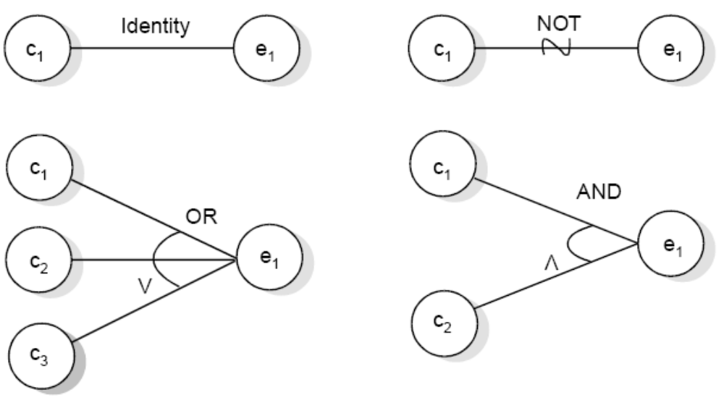
Software Testing
The basic notation for the graph is shown as:
Basic cause effect graph symbols

Slide 80
Software Testing
Myers explained this effectively with following example. “The characters in column 1 must be an A or B. The character in column 2 must be a digit. In this situation, the file update is made. If the character in column 1 is incorrect, message x is issued. If the character in column 2 is not a digit, message y is issued”.
The causes are
c₁: character in column 1 is A
c₂: character in column 1 is B
c₃: character in column 2 is a digit
and the effects are
e₁: update made
e₂: message x is issued
e₃: message y is issued

Slide 81
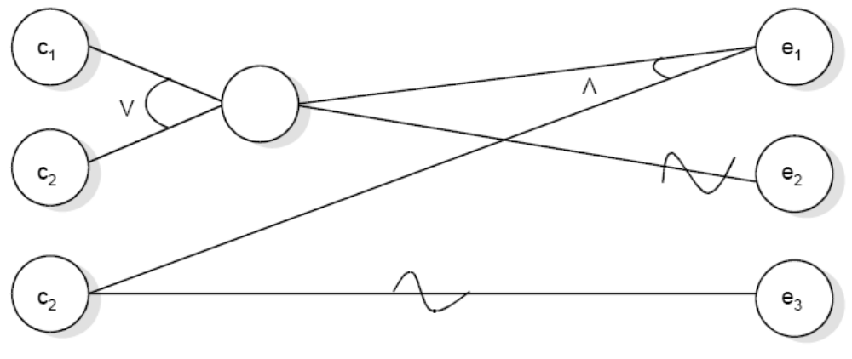
Software Testing
Sample cause effect graph

Slide 82
Software Testing
The E constraint states that it must always be true that at most one of c₁ or c₂ can be 1 (c₁ or c₂ cannot be 1 simultaneously). The I constraint states that at least one of c₁, c₂ and c₃ must always be 1 (c₁, c₂ and c₃ cannot be 0 simultaneously). The O constraint states that one, and only one, of c₁ and c₂ must be 1. The constraint R states that, for c₁ to be 1, c₂ must be 1 (i.e. it is impossible for c₁ to be 1 and c₂ to be 0),

Slide 83
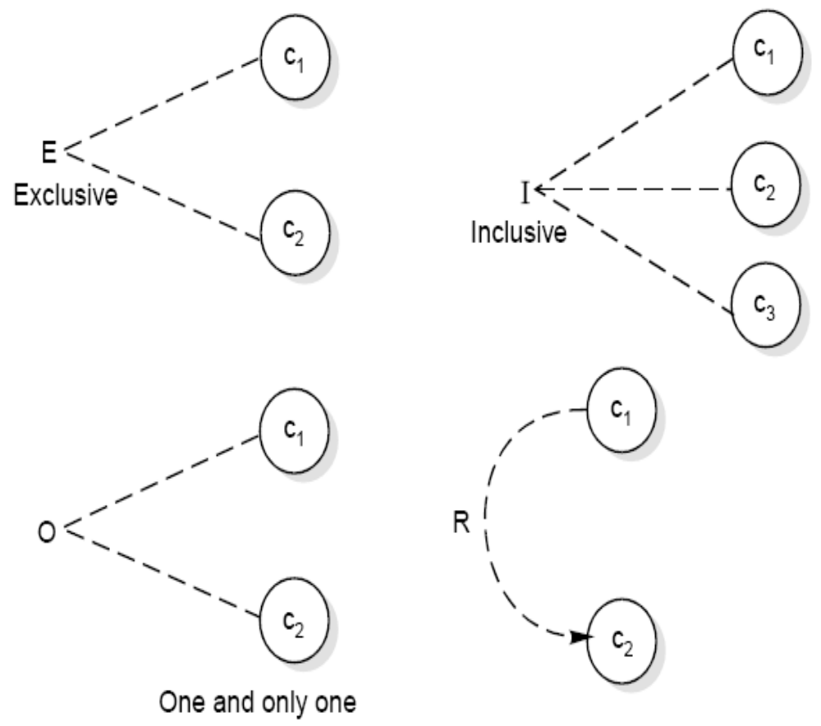
Software Testing
Constraint symbols

Slide 84
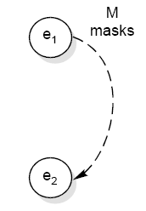
Software Testing
Symbol for masks constraint

Slide 85
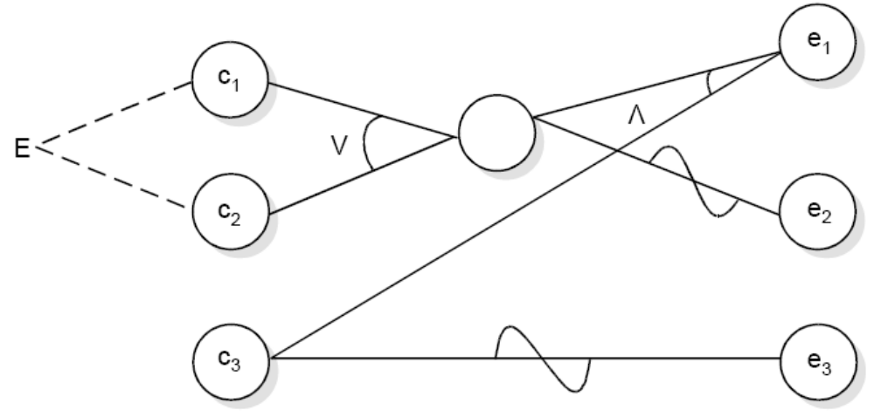
Software Testing
Fig. : Sample cause effect graph with exclusive constraint

Slide 86
Software Testing
Example
Consider a simple program to classify a triangle. Its inputs is a triple of positive integers (say x, y, z) and the data type for input parameters ensures that these will be integers greater than 0 and less than or equal to 100. The program output may be one of the following words:
[Scalene; Isosceles; Equilateral; Not a triangle]
Draw the Cause effect graph and identify the test cases.

Slide 87
Software Testing
Solution
The causes are
  c₁: side x is less than sum of sides y and z
  c₂: side y is less than sum of sides x and z
  c₃: side z is less than sum of sides x and y
  c₄: side x is equal to side y
  c₅: side x is equal to side z
  c₆: side y is equal to side z
and effects are
  e₁: Not a triangle
  e₂: Scalene triangle
  e₃: Isosceles triangle
  e₄: Equilateral triangle
  e₅: Impossible stage

Slide 88
Software Testing
The cause effect graph is shown in and decision table is shown below. The test cases for this problem are available in table 5.
Conditions
C₁: x < y + z ?
0
1
1
1
1
1
1
1
1
1
1
C₂: y < x + z ?
X
0
1
1
1
1
1
1
1
1
1
C₃: z < x + y ?
X
X
0
1
1
1
1
1
1
1
1
C₄: x = y ?
X
X
X
1
1
1
1
0
0
0
0
C₅: x = z ?
X
X
X
1
1
0
0
1
1
0
0
C₆: y = z ?
X
X
X
1
0
1
0
1
0
1
0
e₁: Not a triangle
1
1
1
e₂: Scalene
1
e₃: Isosceles
1
1
1
e₄: Equilateral
1
e₅: Impossible
1
1
1
Decision table

Slide 89
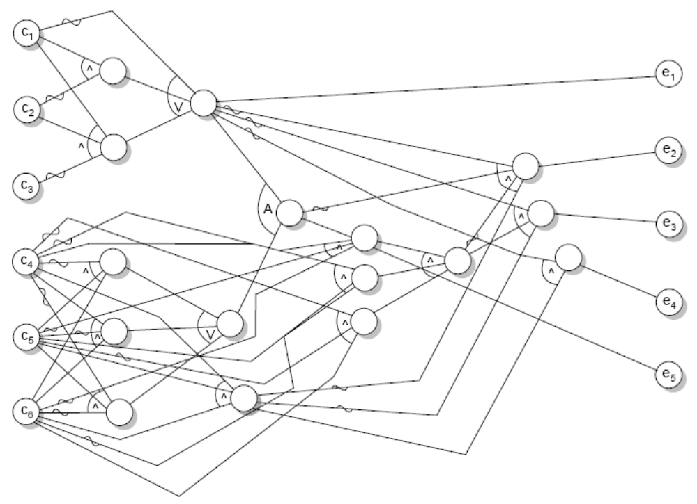
Software Testing
Cause effect graph of triangle problem

